Slide 1

Mogul –interactive platform
Building the Future…one woman at a time.

Slide 2
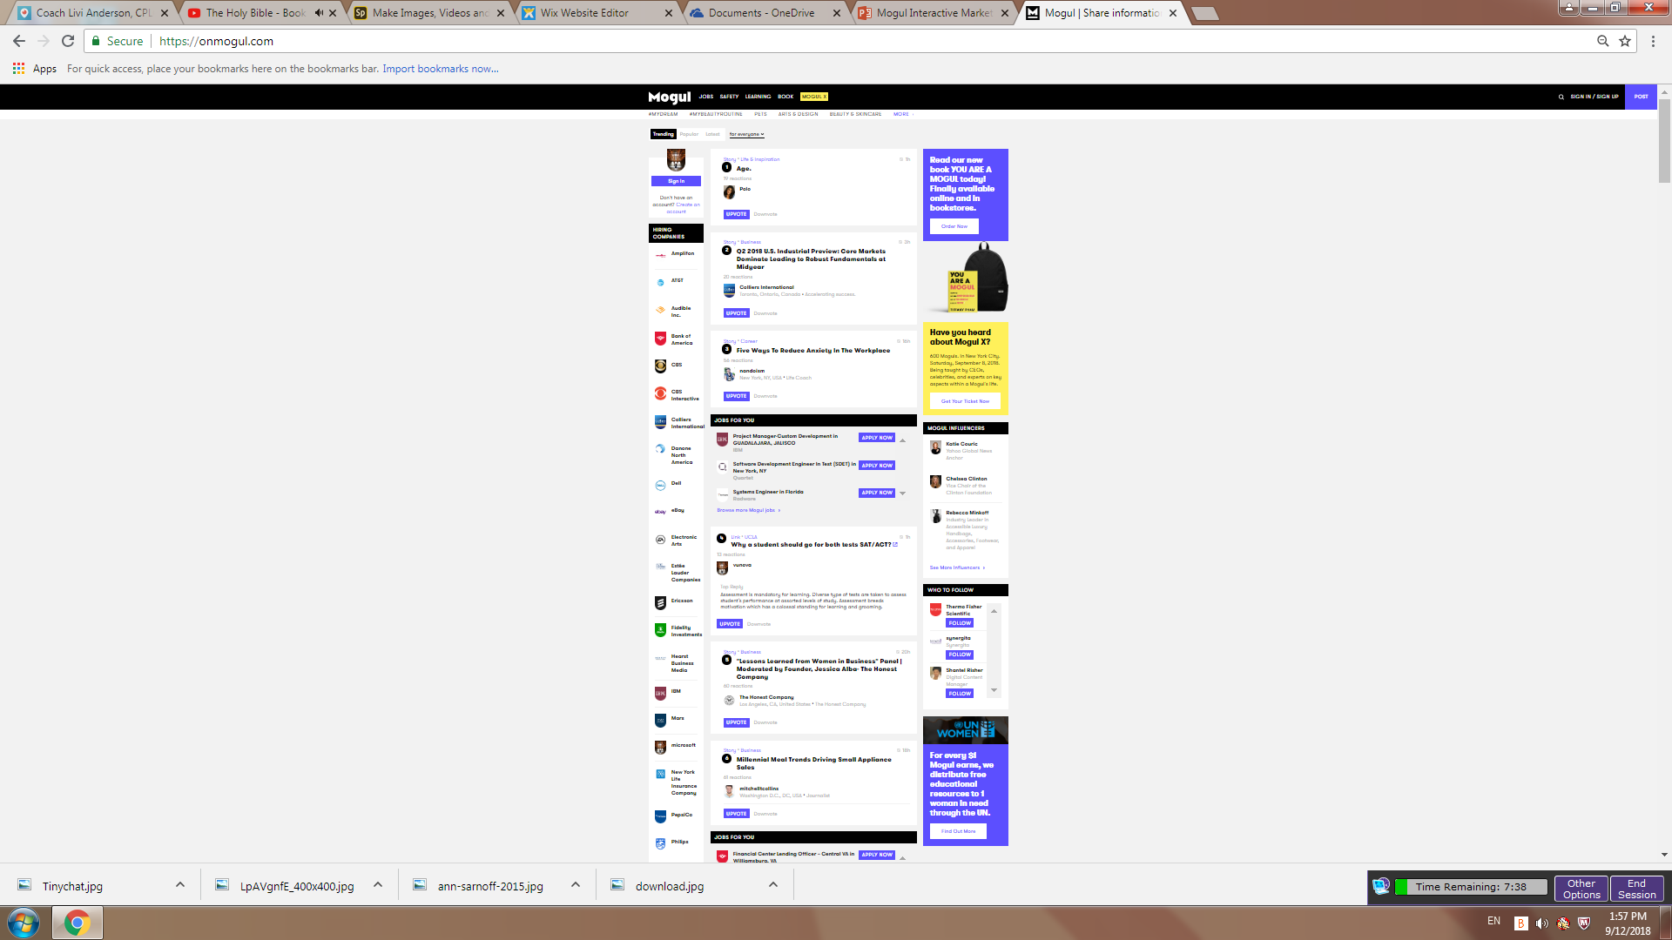
Mogul
It is a platform, and it is very basic and the simplity of it may be how you would like to keep it.
But, what if your missing out, As FOMO (Fear of missing out)

Slide 3

Take your inter activity to the NEXT Level
Now what if you could intergrate the platform. Mogul is you baby I know that.
But what if your missing out on markets of people.
Now did you know that because people think fast imagery and color is more attention grabbing

Slide 4
My Mission
[To bring a solution to the gap in the Mogul social interactive platform
Taking the cause ideas and passion, networking structure and streamlining it to cater to each audience individually and cross connect business influencers and college groups in a more interactive way]

Slide 5
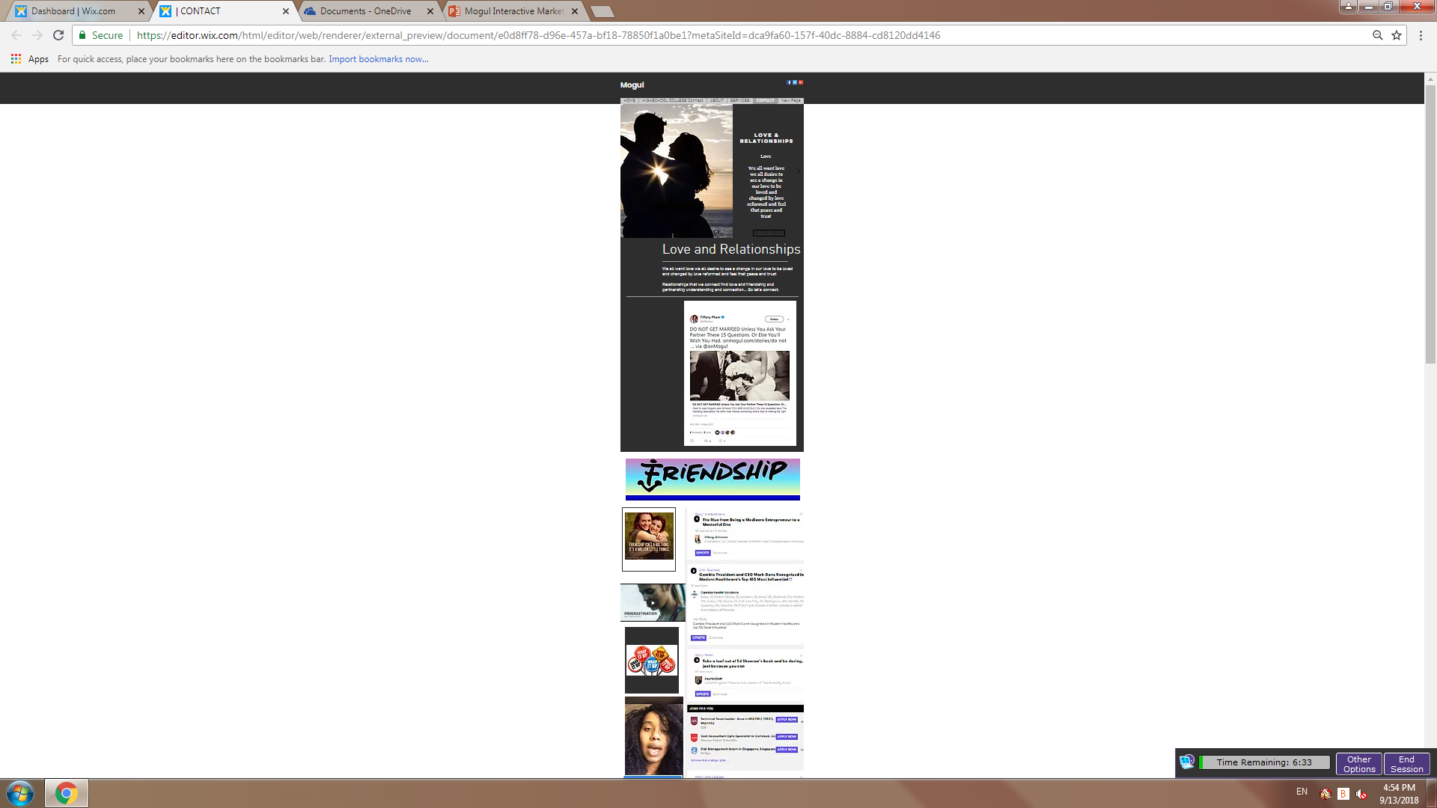
My Mission
You can grab someone with a image or video.
Psychologically people are grabbed by video.
To initiate a emotions, give them knowledge they didn't know from a different perspective in order to shift there thinking and they share and pass it on.

Slide 6
My objective
[To take what Facebook started and enhance it on a different level to market to today’s audience which I can see by looking at the site is majority colleges, but it’s tag line is causes related to woman, so why not make the first thing the audience sees is highlight of that thing ]

Slide 7
My competitive Advantage
[Go to that next step that next phase of what video is and become the leader in it and all other social media and follow.
You would be putting yourself in line with to surpass Facebook, buy intergrating, either collaborating with platforms as Facebook Instagram, pintrist or even creating your own veriation of what they have and identifying there natural next step then doing it FIRST]

Slide 8

Pop up Reformatting
Think about it, you have a pop up add on your site what if you had a long frame video that said.
Hi I'm Tiffany Pham
the author of “You Are A Mogul “ hope the book is blessing you. if you haven't checked it out click on the button...
Right over there...you see it,
click it check it out.
Have a image of the book cover as a button and click on it.

Slide 9
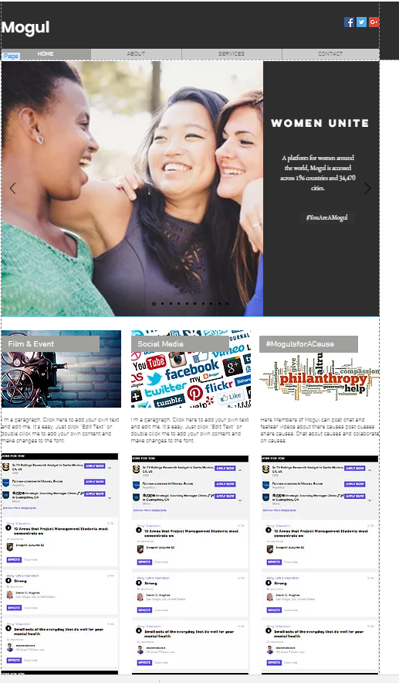
Our marketing plan
Giving the audience free or low fee, the take back for them is the get more potential customers on what they “see”
You give the viewer coming in something to look at and make them excited there are so many things to choose from. You may not be selling anything new but the vibracy and the packaging of what the initial viewer interacts with on the page can be mind blowing,

Slide 10
Our .marketing plan
A great social media strategy person said “most people won’t look past the fold line of the site, so you must grab them and unite there hearts to your cause then show them what they get, some simple tweaks could fix it
But the more major could blow it out the ball park.

Slide 11
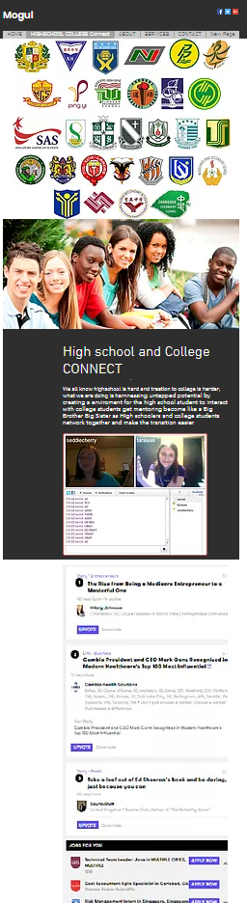
Our Marketing plan
There can be more pinpointed activity, The very first thing I noticed is you have a heavy audience of college's and college students I think that that should be grouped in its own category,
Because when I first came in I didn’t know where to go and as a business person not interested in college I might leave if I have to discover where I need to post
The few other titles that are mixed in separate them because its, to hard to find and you should have sections like
Inspiration
Testimony
Testimonials (for businesses)

Slide 12
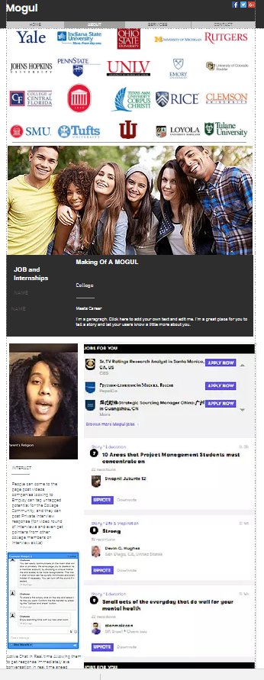
Our Marketing Plan
You have a heavy college base harness what college kids love and deal With. Give them what they need and get more activity because its different.
Connecting High School students to college mentors (college vollenteering credit)
Connecting college students and job/ internships with employers through video chat or one to 15minute pre interview and having mogul members critric
Connect foodie and college experience, if you went to college you know there is benge setting at study jams so why not have a college food hub for all the hottest eats in the area of all these colleges

Slide 13

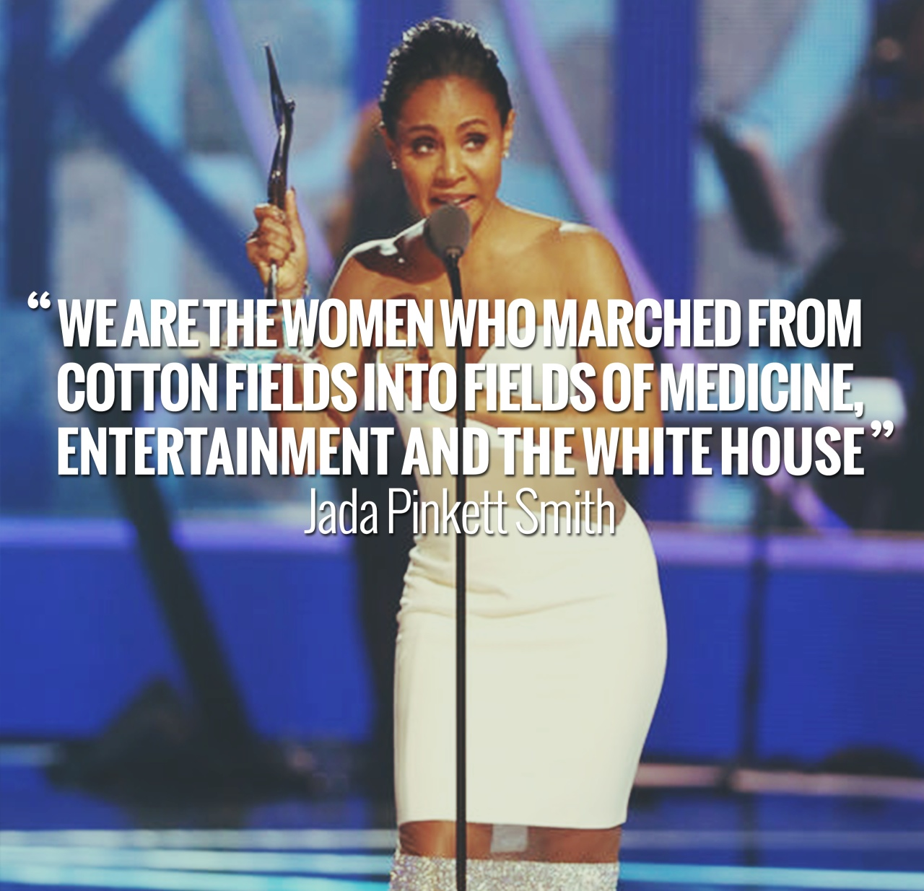
Our Marketing Plan
What if you had a video that was like a insta video but had color visual and sound snippet with a catchy tune that the advertisement would be remembered.
With apps like musicly what if you could create ads that were 30-57sec clip of a catchy tune and imagery and close out with a meme of the product, service people will by it and particate in those events a purchase those products and create a different type interaction in the community
Our use a motivational video to pull on the hear strings

Slide 14
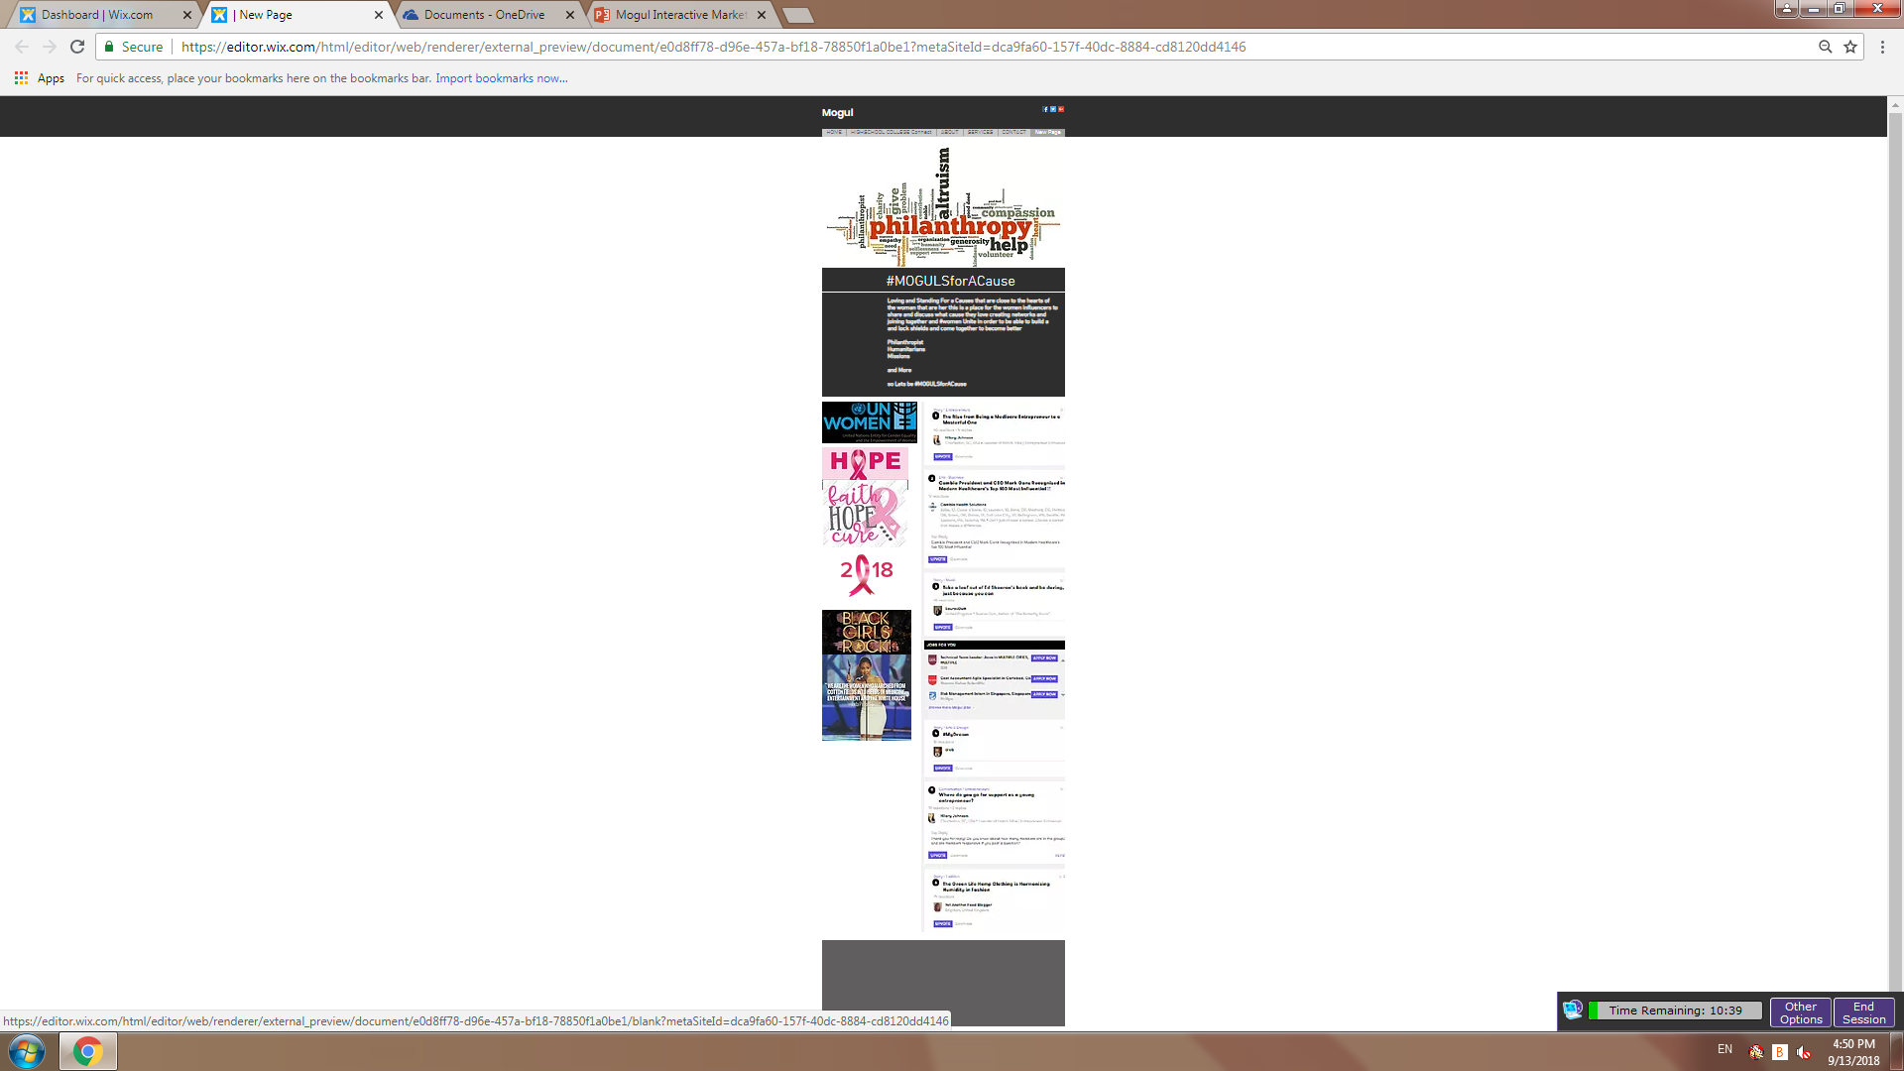



Highlight you’re Cause
The main page should also not only grabb your attention but hit a power pack punch for female causes
Woman UN
Girls Rock#MOGULSforACause
Breast cancer awareness
Gender Equality in the work place
Should all be on the interactive slider

Slide 15
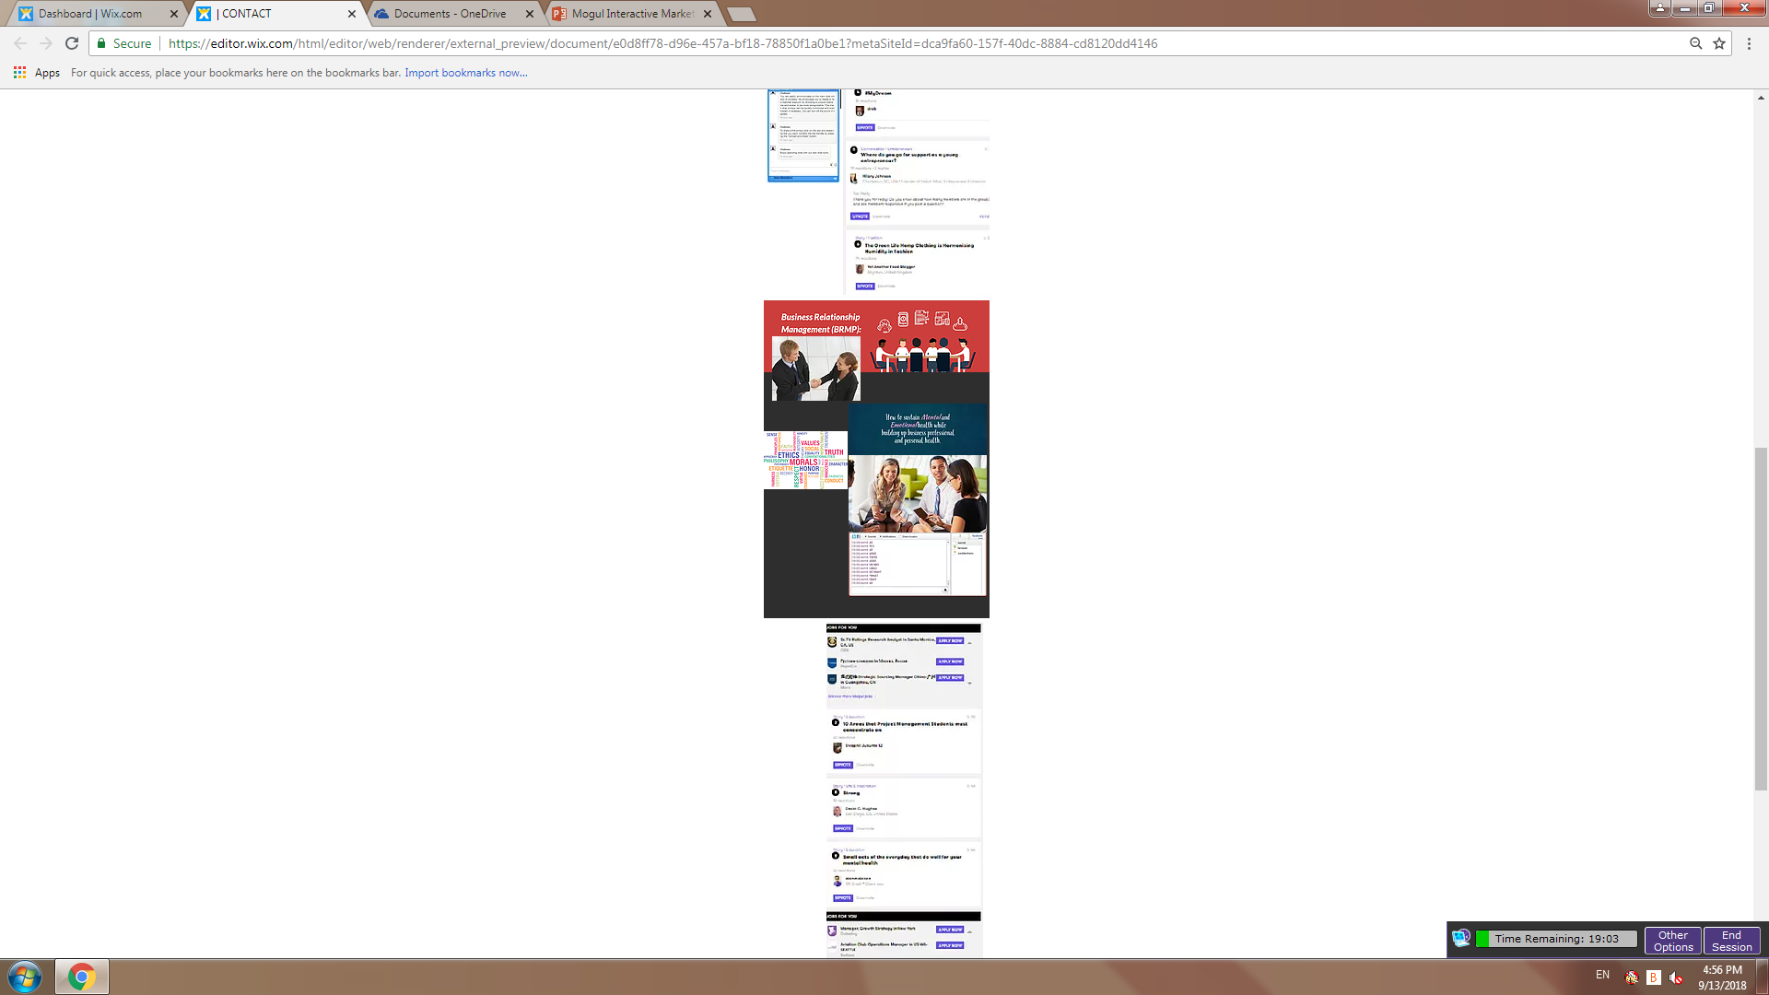
Love & Relationship
Highlight Love and Relationship
Your audience is prodominatly college and working woman
Having this page a lots for woman to find
Friendships
Business relationships
Learn how not to strike out in love
For Colleve woman (highlighting your article on 15 questions you should be asking before getting in a relationship
Advice and support chats and Convos in the feed
Awareness to protect yourself
  Physically
  Mentally & Emotionally.

Slide 16
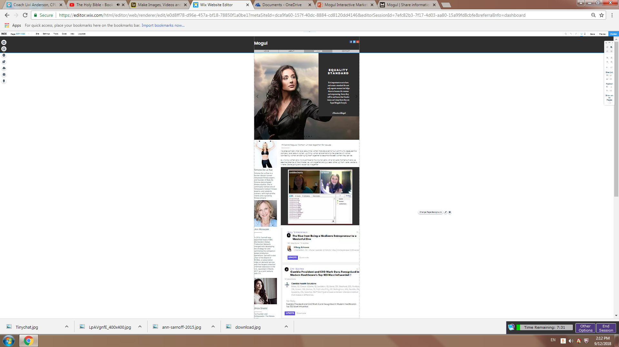
Our Marketing Plan
Use the current marketing strategy but what if you could restructure what you offer,through your Membership service tweaking access, or stake in the company, higher level membership access, for people wanting to talk to your moguls on a brand new feature, have high end moguls give them a stake in the company or even Free advertising on the site.

Slide 17
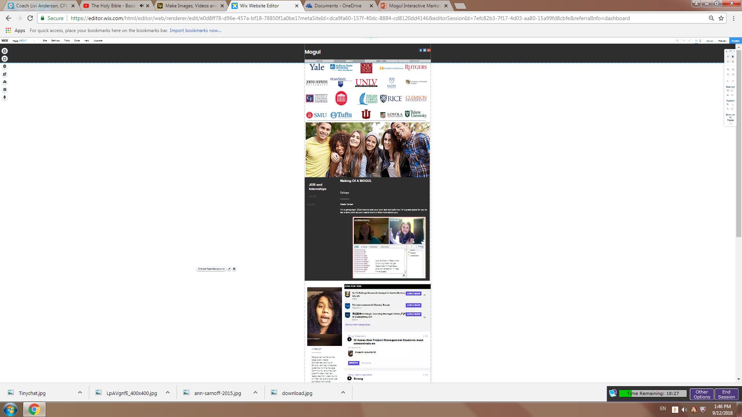
Our Marketing plan
Gives college kids 1 on 1 access to the High end moguls or even have interactive rooms, seminars or more for the High end Moguls to give the college grads access to content first. Or create these rooms to a lot high end clients the ability to share (first looks) at projects they are going to be involved in and just chat. Q&A of the week or month.{In the Chat Box Version}

Slide 18
My goal
To enhance and expand business for Mogul interface in order to harness the untapped potential that Mogul has and give the clients the best experience possible.

Slide 19

Promotion of who we are
We Are Moguls
So are You
#BecomeAMogul
Because #YouAreAMogul
#MogulintheMaking

